Slide 1
8. Limit theorems

Slide 2
Many times we do not need to calculate probabilities exactly
Sometimes it is enough to know that a probability is very small (or very large)
E.g. P(earthquake tomorrow) = ?
This is often a lot easier

Slide 3
What do you think?
I toss a coin 1000 times. The probability that I get 14 consecutive heads is
A
B
C
< 10%
≈ 50%
> 90%

Slide 4
Consecutive heads
Let N be the number of occurrences of 14 consecutive heads in 1000 coin flips.
N = I₁ + … + I₉₈₇
where I_{i} is an indicator r.v. for the event
“14 consecutive heads starting at position i”
E[I_{i} ] = P(I_{i} = 1) = 1/2¹⁴
E[N ] = 987 ⋅ 1/2¹⁴
= 987/16384
≈ 0.0602

Slide 5
Markov’s inequality
For every non-negative random variable X and every value a:
P(X ≥ a) ≤ E[X] / a.
E[N ] ≈ 0.0602
P[N ≥ 1] ≤ E[N ] / 1 ≤ 6%.

Slide 6
Proof of Markov’s inequality
For every non-negative random variable X: and every value a:
P(X ≥ a) ≤ E[X] / a.
E[X ] = E[X | X ≥ a ] P(X ≥ a) + E[X | X < a ] P(X < a)
≥ a
≥ 0
≥ 0
E[X ] ≥ a P(X ≥ a) + 0.

Slide 7
Hats
1000 people throw their hats in the air. What is the probability at least 100 people get their hat back?
Solution
N = I₁ + … + I₁₀₀₀
where I_{i} is the indicator for the event that person i gets their hat. Then E[I_{i} ] = P(I_{i} = 1) = 1/n
E[N ] = n 1/n = 1
P[N ≥ 100] ≤ E[N ] / 100 = 1%.

Slide 8
Patterns
A coin is tossed 1000 times. Give an upper bound on the probability that the pattern HH occurs:
(a) at least 500 times
(b) at most 100 times

Slide 9
Patterns
(a)
Let N be the number of occurrences of HH.
Last time we calculated E[N ] = 999/4 = 249.75.
P[N ≥ 500] ≤ E[N ] / 500
= 249.75/500
≈ 49.88%
so 500+ HHs occur with probability ≤ 49.88%.
(b)
P[N ≤ 100] ≤ ?
P[N ≤ 100] =
P[999 – N ≥ 899]
≤ E[999 – N ] / 899
= (999 – 249.75)/ 899
≤ 83.34%

Slide 10
Chebyshev’s inequality
For every random variable X and every t:
P(|X – μ| ≥ tσ) ≤ 1 / t².
where μ = E[X], σ = √Var[X].

Slide 11
Patterns
E[N ] = 999/4 = 249.75
μ = 249.75
Var[N] = (5⋅999 – 7)/16 = 311.75
σ ≈ 17.66
(a)
P(X ≥ 500)
≤ P(|X – μ| ≥ 14.17σ)
≤ 1/14.17²
≈ 0.50%
(b)
P(X ≤ 100)
≤ P(|X – μ| ≥ 8.47σ)
≤ 1/8.47²
≈ 1.39%

Slide 12
Proof of Chebyshev’s inequality
For every random variable X and every a:
P(|X – μ| ≥ tσ) ≤ 1 / t².
where μ = E[X], σ = √Var[X].
P(|X – μ| ≥ tσ)
= P((X – μ)² ≥ t²σ²)
≤ E[(X – μ)²] / t²σ²
= 1 / t².

Slide 13


An illustration
μ
a
Markov’s inequality:
P( X ≥ a ) ≤ μ / a.
0
μ – tσ
μ
μ + tσ
Chebyshev’s inequality:
P(|X – μ| ≥ tσ ) ≤ 1 / t².
σ

Slide 14


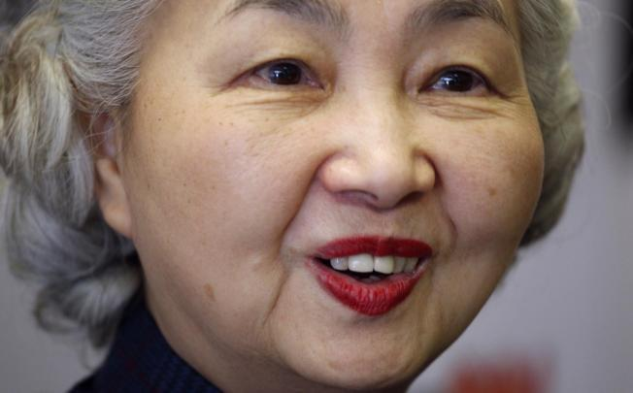









Polling
1
7
8
3
2
5
4
6
9

Slide 15
Polling
1 if
i
X_{i} =
0 if
i
X₁,…, X_{n} are independent Bernoulli(μ)
where μ is the fraction of blue voters
X = X₁ + … + X_{n}
X/n is the pollster’s estimate of μ

Slide 16
Polling
How accurate is the pollster’s estimate X/n?
X = X₁ + … + X_{n}
μ = E[X_{i}], σ = √Var[X_{i}]
E[X] =
E[X₁] + … + E[X_{n}]
= μn
Var[X]
= Var [X₁] + … + Var [X_{n}]
= σ²n

Slide 17
Polling
E[X] = μn
X = X₁ + … + X_{n}
Var[X] = σ²n
P( |X – μn| ≥ tσ √n ) ≤ 1 / t².
εn
δ
P( |X/n – μ| ≥ ε) ≤ δ.
sampling
error
confidence
error

Slide 18
The weak law of large numbers
X₁,…, X_{n} are independent with same p.m.f. (p.d.f.)
μ = E[X_{i}], σ = √Var[X_{i}],
X = X₁ + … + X_{n}
For every ε, δ > 0 and n ≥ σ²/(ε²δ):
P(|X/n – μ| ≥ ε) ≤ δ

Slide 19
Polling
For ε, δ > 0 and n ≥ σ²/(ε²δ):
P(|X/n – μ| ≥ ε) ≤ δ
Say we want confidence error δ = 10% and sampling error ε = 5% . How many people should we poll?
For Bernoulli(μ) samples, σ² = μ (1 – μ) ≤ 1/4
n ≥ σ²/(ε²δ) ≥ 4000σ²
This suggests we should poll about 1000 people.

Slide 20
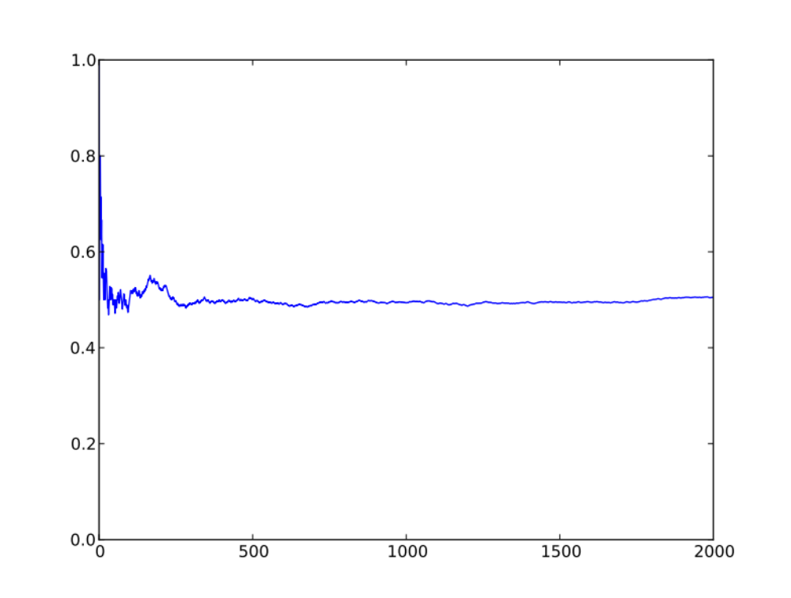
A polling experiment
X₁, …, X_{n} independent Bernoulli(1/2)
X₁ + … + X_{n}
n
n

Slide 21
A more precise estimate
X₁,…, X_{n} are independent with same p.m.f. (p.d.f.)
Let’s assume n is large.
Weak law of large numbers:
X₁ + … + X_{n} ≈ μn
with high probability
P( |X – μn| ≥ tσ √n ) ≤ 1 / t².
this suggests X₁ + … + X_{n} ≈ μn + Tσ √n

Slide 22
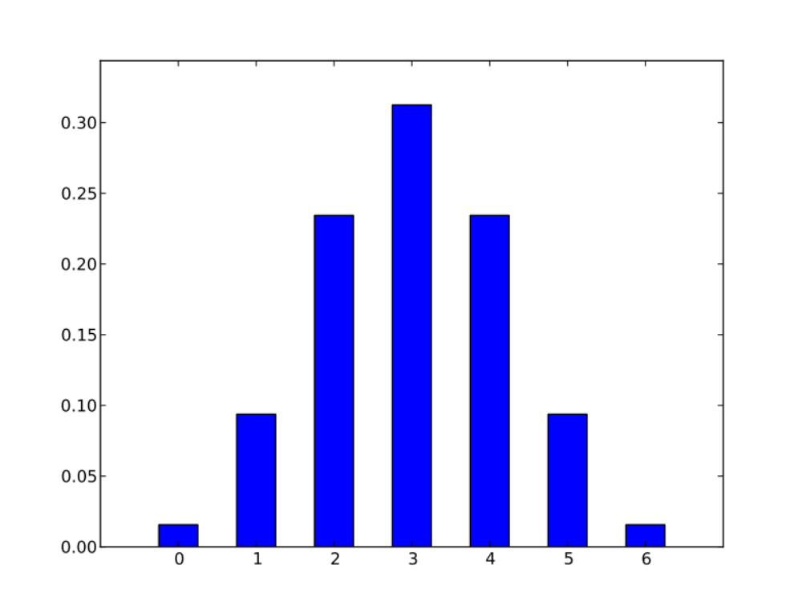
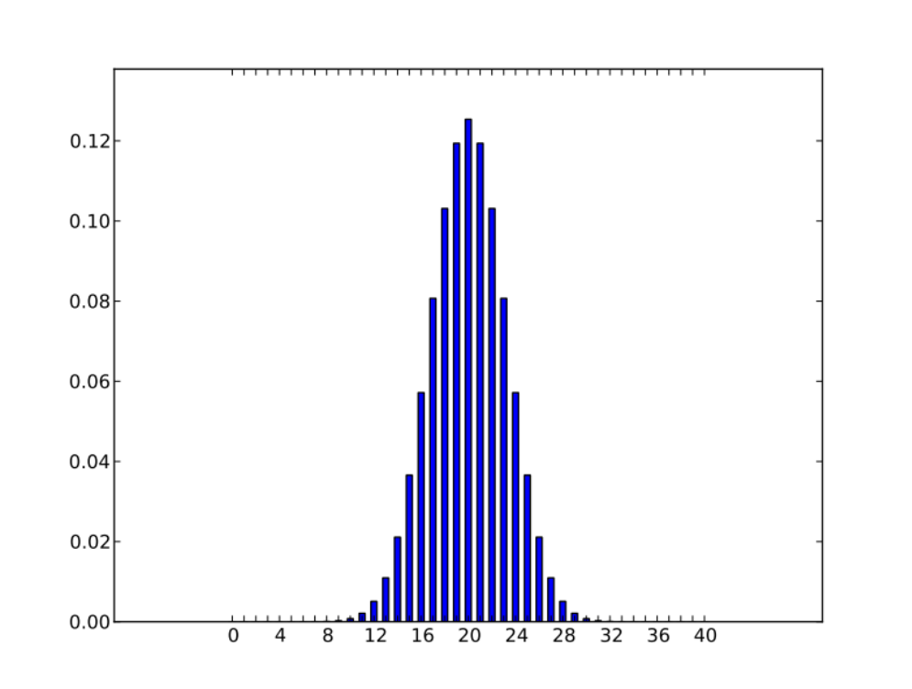
Some experiments
X = X₁ + … + X_{n}
X_{i} independent Bernoulli(1/2)
n = 6
n = 40

Slide 23
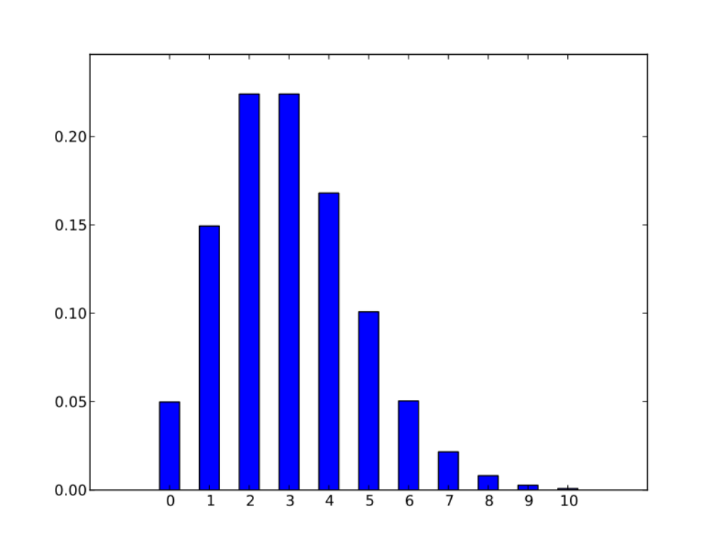
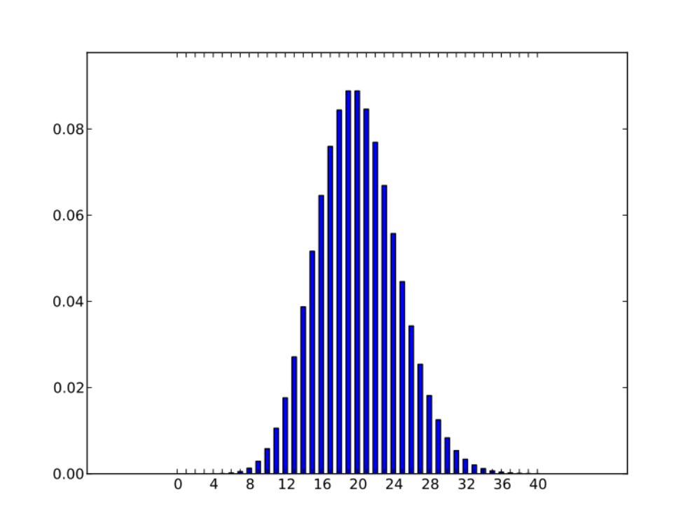
Some experiments
X = X₁ + … + X_{n}
X_{i} independent Poisson(1)
n = 3
n = 20

Slide 24
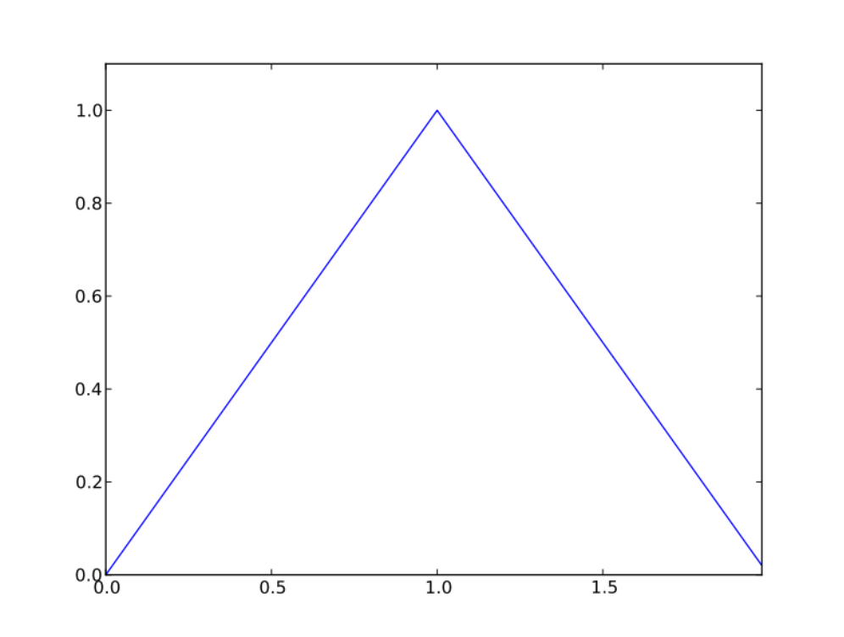
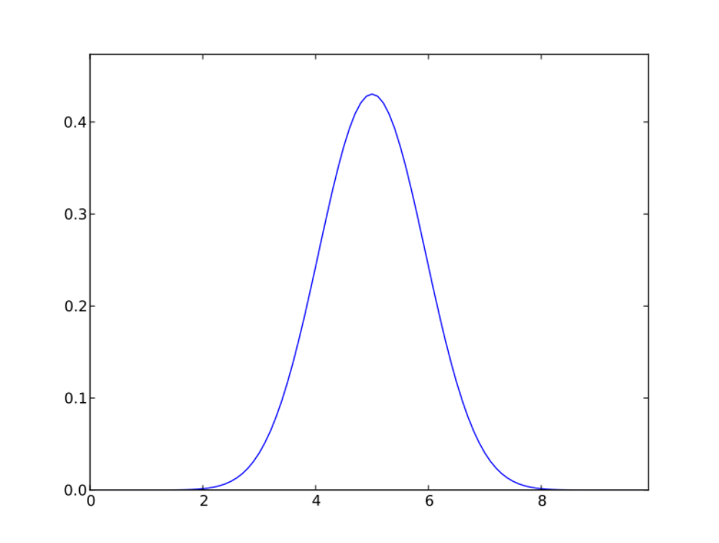
Some experiments
X = X₁ + … + X_{n}
X_{i} independent Uniform(0, 1)
n = 2
n = 10

Slide 25
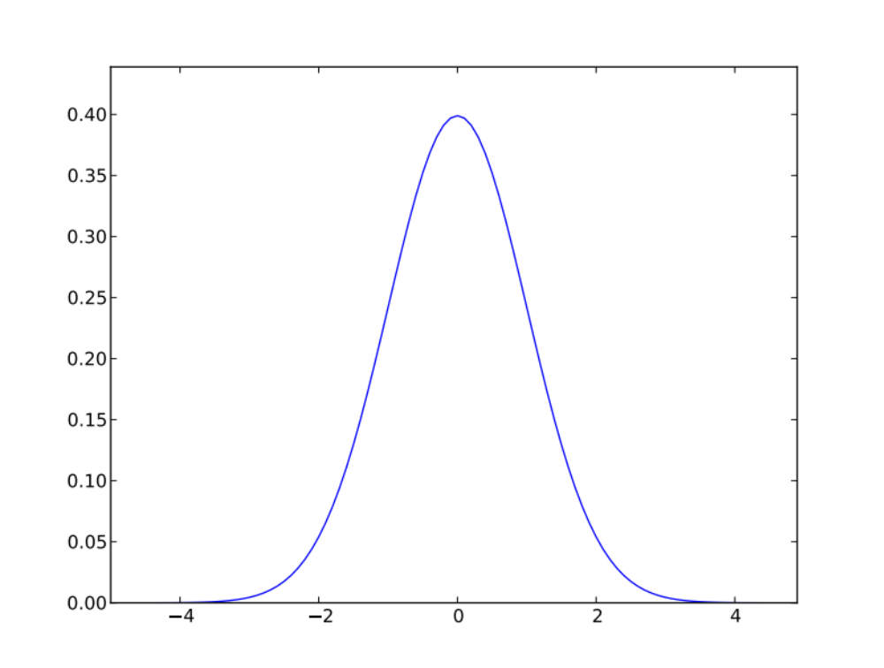
The normal random variable
f(t) = (2π)^{-½} e^{-t /2}
²
p.d.f. of a normal random variable
t

Slide 26
The central limit theorem
X₁,…, X_{n} are independent with same p.m.f. (p.d.f.)
μ = E[X_{i}], σ = √Var[X_{i}], X = X₁ + … + X_{n}
For every t (positive or negative):
lim P(X ≥ μn + tσ √n ) = P(T ≥ t)
n → ∞
where T is a normal random variable.

Slide 27
Polling again
Say we want confidence error δ = 10% and sampling error ε = 5% . How many people should we poll?
Probability model
μ = fraction that will vote blue
X = X₁ + … + X_{n}
X_{i} independent Bernoulli(μ)
E[X_{i}] = μ, σ = √Var[X_{i}] = √μ(1 - μ) ≤ ½.

Slide 28
Polling again
lim P(X ≥ μn + tσ √n ) = P(T ≥ t)
tσ √n = 5% n
n → ∞
5% n
t = 5%√n/σ
lim P(X ≤ μn – tσ √n ) = P(T ≤ -t)
n → ∞
5% n
lim P(X/n is not within 5% of μ) = P(T ≥ t) + P(T ≤ -t)
n → ∞
= 2 P(T ≤ -t)

Slide 29
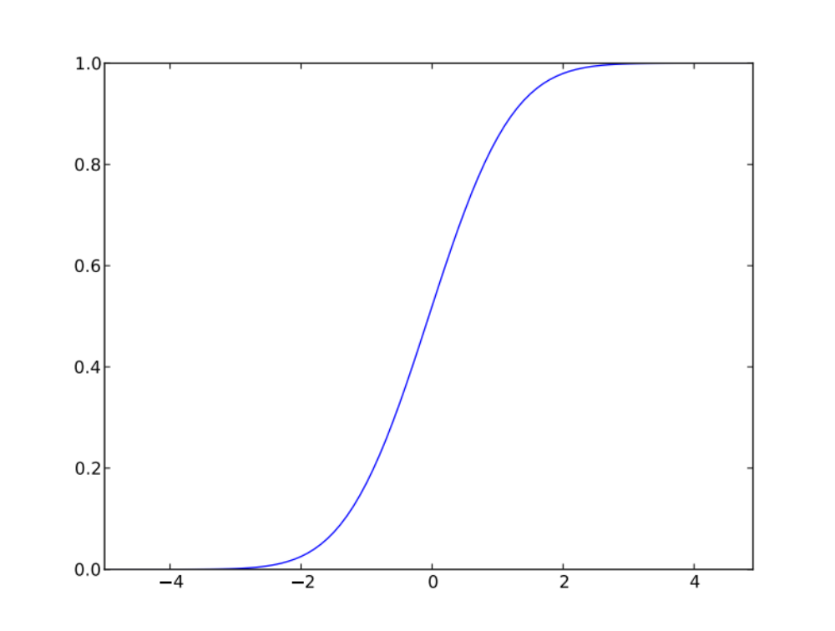
The c.d.f. of a normal random variable
P(T ≥ t)
F(t)
P(T ≤ -t)
t
-t
t

Slide 30
Polling again
confidence error = 2 P(T ≤ -t)
= 2 P(T ≤ -5%√n/σ)
≤ 2 P(T ≤ -√n/10)
We want a confidence error of ≤ 10%:
We need to choose n so that P(T ≤ -√n/10) ≤ 5%.

Slide 31
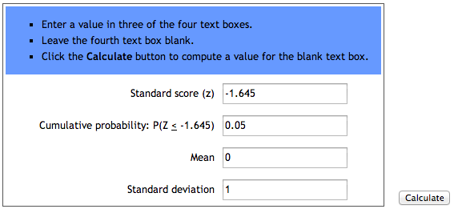
Polling again
P(T ≤ -√n/10) ≤ 5%
http://stattrek.com/online-calculator/normal.aspx
-√n/10 ≈ -1.645
F(t)
n ≈ 16.45² ≈ 271
t

Slide 32
Party
Ten guests arrive independently at a party between 8pm and 9pm.
Give an estimate of the probability that the average arrival time of a guest is past 8:40pm.

